Slide 1
.Net & Azure
ISAH 20 April 2022

Slide 2
Overzicht
Dag 1 (20-4): Multi-Threading, .NET
Dag 2 (22-4): ARM, Azure SQL
Dag 3 (28-4): Azure Security
Dag 4 (5-5): Kubernetes, Docker, Helm

Slide 3
tasks
Use an Action delegate
Use an anonymous delegate/anonymous method
Task task1 = new Task(new Action(MyMethod));
Task task2 = new Task(delegate
{
Console.WriteLine("Task 2 reporting");
});

Slide 4
tasks
Use lambda expressions (recommended)
Task task2 = new Task(() =>
{
Console.WriteLine(" Task 2 reporting");
});

Slide 5
Controlling task execution
To start a task:
Task.Start instance method
Task.Factory.StartNew static method
Task.Run static method
To wait for tasks to complete:
Task.Wait instance method
Task.WaitAll static method
Task.WaitAny static method

Slide 6
Returning a value from a task
Use the Task<TResult> class
Specify the return type in the type argument
Get the result from the Result property
Task<string> task1 = Task.Run<string>( () =>
DateTime.Now.DayOfWeek.ToString() );
Console.WriteLine("Today is {0}", task1.Result);

Slide 7
Cancelling long-running tasks
Pass a cancellation token as an argument to the delegate method
Request cancellation from the joining thread
In the delegate method, check whether the cancellation token is cancelled
Return or throw an OperationCanceledException exception

Slide 8
Cancelling example

Slide 9
https://docs.microsoft.com/en-us/dotnet/api/system.threading.tasks.task?view=net-6.0

Slide 10
Task example

Slide 11
Task exercise
Make a method that rolls dice for you. Roll 10000 dice and let the user decide which number he thinks will be rolled the most. See if the user is correct.
First do this without multithreading and after that do it with multithreading

Slide 12
Running tasks in parallel
Use Parallel.Invoke to run multiple tasks simultaneously
Use Parallel.For to run for loop iterations in parallel
Use Parallel.ForEach to run foreach loop iterations in parallel
Use PLINQ to run LINQ expressions in parallel
Parallel.Invoke( () => MethodForFirstTask(),
() => MethodForSecondTask(),
() => MethodForThirdTask() );

Slide 13
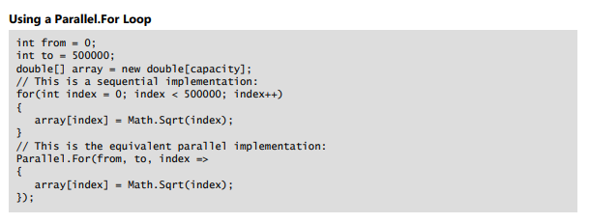
Parallel.for

Slide 14
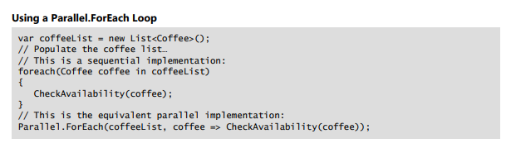
Parallel.foreach

Slide 15
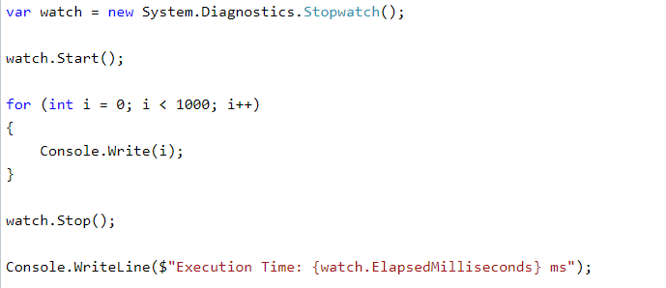
.Net stopwatch class
https://docs.microsoft.com/en-us/dotnet/api/system.diagnostics.stopwatch?view=net-6.0

Slide 16
Parallel.for exercise
Roll the 10000 dice again and check the difference in performance with the Stopwatch class for:
Single Thread
Parallel.For

Slide 17
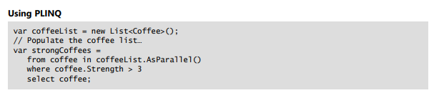
PLINQ
https://docs.microsoft.com/en-us/dotnet/standard/parallel-programming/introduction-to-plinq

Slide 18
Plinq exercise
Create a Console app and do the following:
Populate an integer array with 10 million elements, value of those elements should be between 1 and 500 (use Enumerable.Range and Random function).
Perform the following operation in a normal LINQ way and using PLINQ and compare their time taken for:
A) Sum of all the elements in the array.
B) Counting the distinct elements in the array.
Notes:
https://www.chegg.com/homework-help/questions-and-answers/exercise-05-based-parallel-linq-plinq-5-marks-create-console-app-net-framework-following-p-q79867002

Slide 19
Linking tasks
Use task continuations to chain tasks together:
Task.ContinueWith method links continuation task to antecedent task
Continuation task starts when antecedent task completes
Antecedent task can pass result to continuation task
Use nested tasks if you want to start an independent task from a task delegate
Use child tasks if you want to start a dependent task from a task delegate

Slide 20
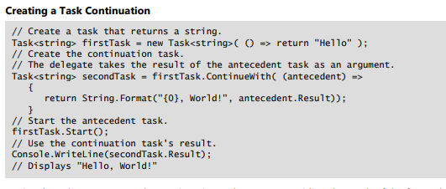
Linking tasks example: Continuation
Continuation tasks enable you to chain multiple tasks together so that they execute one after another. The task that invokes another task on completion is known as the antecedent, and the task that it invokes is known as the continuation. You can pass data from the antecedent to the continuation, and you can control the execution of the task chain in various ways

Slide 21
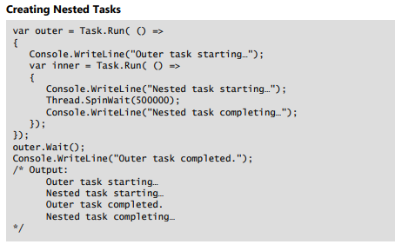
Linking tasks example: nested

Slide 22
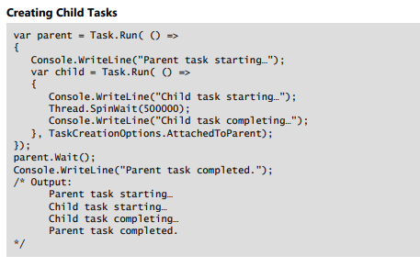
Linking tasks example: child

Slide 23
Linking tasks exercise

Slide 24
Handling task exceptions
Call Task.Wait to catch propagated exceptions
Catch AggregateException in the catch block
Iterate the InnerExceptions property and handle individual exceptions
try
{
task1.Wait();
}
catch(AggregateException ae)
{
foreach(var inner in ae.InnerExceptions)
{
// Deal with each exception in turn.
}
}

Slide 25
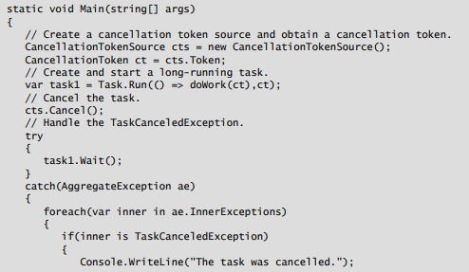
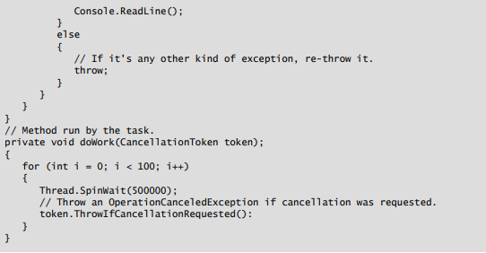
Task exception example
Notes:
static void Main(string[] args)
{
// Create a cancellation token source and obtain a cancellation token.
CancellationTokenSource cts = new CancellationTokenSource();
CancellationToken ct = cts.Token;
// Create and start a long-running task.
var task1 = Task.Run(() => doWork(ct),ct);
// Cancel the task.
cts.Cancel();
// Handle the TaskCanceledException.
try
{ task1.Wait(); }
catch(AggregateException ae)
{ foreach(var inner in ae.InnerExceptions)
{ if(inner is TaskCanceledException)
{ Console.WriteLine("The task was cancelled.");
Console.ReadLine(); }
else {
// If it's any other kind of exception, re-throw it.
throw; } } } }
// Method run by the task.
private void doWork(CancellationToken token)
{
for (int i = 0; i < 100; i++)
{ Thread.SpinWait(500000);
// Throw an OperationCanceledException if cancellation was requested.
token.ThrowIfCancellationRequested(): } }

Slide 26
Windows programming using dispatcher
In the .NET Framework, each thread is associated with a Dispatcher object. The dispatcher is responsible for maintaining a queue of work items for the thread. When you work across multiple threads, for example, by running asynchronous tasks, you can use the Dispatcher object to invoke logic on a specific thread. You typically need to do this when you use asynchronous operations in graphical applications. For example, if a user clicks a button in a Windows Presentation Foundation (WPF) application, the click event handler runs on the UI thread. If the event handler starts an asynchronous task, that task runs on the background thread. As a result, the task logic no longer has access to controls on the UI, because these are all owned by the UI thread. To update the UI, the task logic must use the Dispatcher.BeginInvoke method to queue the update logic on the UI thread.

Slide 27
Dispatcher
To update a UI element from a background thread:
Get the Dispatcher object for the thread that owns the UI element
Call the BeginInvoke method
Provide an Action delegate as an argument
lblTime.Dispatcher.BeginInvoke(new Action(() =>
SetTime(currentTime)));

Slide 28
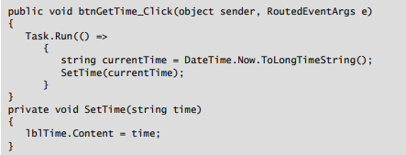
Wrong way to update a ui element

Slide 29
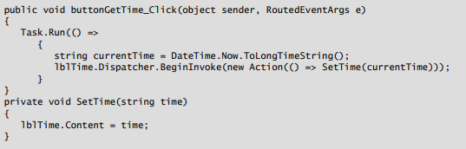
correct way to update a ui element

Slide 30
Using await and async
The async and await keywords were introduced in the .NET Framework 4.5 to make it easier to perform asynchronous operations. You use the async modifier to indicate that a method is asynchronous. Within the async method, you use the await operator to indicate points at which the execution of the method can be suspended while you wait for a long-running operation to return. While the method is suspended at an await point, the thread that invoked the method can do other work.
Unlike other asynchronous programming techniques, the async and await keywords enable you to run logic asynchronously on a single thread. This is particularly useful when you want to run logic on the UI thread, because it enables you to run logic asynchronously on the same thread without blocking the UI.

Slide 31
Using await and async
Add the async modifier to method declarations
Use the await operator within async methods to wait for a task to complete without blocking the thread
private async void btnLongOperation_Click(object sender, RoutedEventArgs e)
{
...
Task<string> task1 = Task.Run<string>(() =>
{
...
}
lblResult.Content = await task1;
}

Slide 32
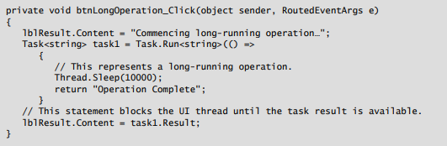
Synchronous operation
UI will freeze for the duration

Slide 33
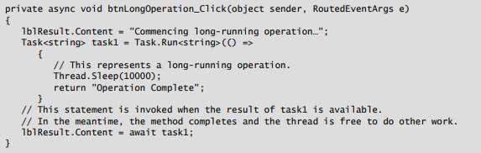
aSynchronous operation
Notice that when you use the await operator, you do not await the result of the task—you await the task itself. When the .NET runtime executes an async method, it effectively bypasses the await statement until the result of the task is available. The method returns and the thread is free to do other work. When the result of the task becomes available, the runtime returns to the method and executes the await statement.

Slide 34
Await async
https://docs.microsoft.com/en-us/dotnet/csharp/programming-guide/concepts/async/

Slide 35
Awaitable methods
The await operator is always used to wait for a task to complete
If your synchronous method returns void, the asynchronous equivalent should return Task
If your synchronous method has a return type of T, the asynchronous equivalent should return Task<T>

Slide 36
Creating and invoking callback methods
Use the Action<T> delegate to represent your callback method
Add the delegate to your asynchronous method parameters
Invoke the delegate asynchronously within your method
public async Task GetCoffees(Action<IEnumerable<string>> callback)
await Task.Run(() => callback(coffees));

Slide 37
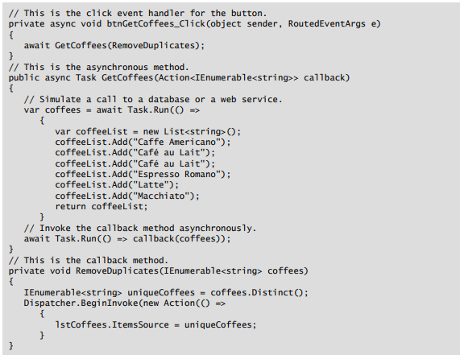

Slide 38
APM – asynchronous programming model
Use the TaskFactory.FromAsync method to call methods that implement the APM pattern
HttpWebRequest request =
(HttpWebRequest)WebRequest.Create(url);
HttpWebResponse response =
await Task<WebResponse>.Factory.FromAsync(
request.BeginGetResponse,
request.EndGetResponse,
request) as HttpWebResponse;

Slide 39
Handling exceptions from await methods
Use a conventional try/catch block to catch exceptions in asynchronous methods
Subscribe to the TaskScheduler.UnobservedTaskException event to create an event handler of last resort
TaskScheduler.UnobservedTaskException +=
(object sender, UnobservedTaskExceptionEventArgs e) =>
{
// Respond to the unobserved task exception.
}

Slide 40
Threads
https://docs.microsoft.com/en-us/dotnet/api/system.threading.thread?view=net-6.0

Slide 41
Thread example

Slide 42
Thread exercise

Slide 43
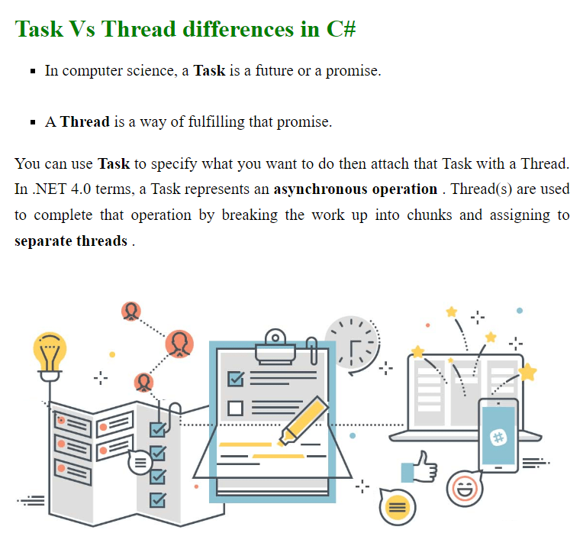
Threads vs tasks
http://csharp.net-informations.com/language/task.htm

Slide 44
locks
Create a private object to apply the lock to
Use the lock statement and specify the locking object
Enclose your critical section of code in the lock block
private object lockingObject = new object();
lock (lockingObject)
{
// Only one thread can enter this block at any one time.
}

Slide 45
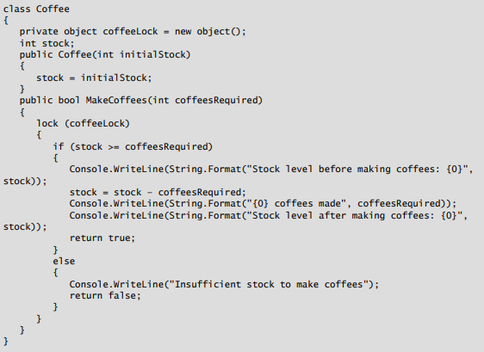
Lock example

Slide 46
Synchronization principles
Use the ManualResetEventSlim class to limit resource access to one thread at a time
Use the SemaphoreSlim class to limit resource access to a fixed number of threads
Use the CountdownEvent class to block a thread until a fixed number of tasks signal completion
Use the ReaderWriterLockSlim class to allow multiple threads to read a resource or a single thread to write to a resource at any one time
Use the Barrier class to block multiple threads until they all satisfy a condition

Slide 47
More synchronization principles
https://docs.microsoft.com/en-us/dotnet/standard/threading/overview-of-synchronization-primitives

Slide 48
Concurrent collections
The standard collection classes in the .NET Framework are, by default, not thread-safe. When you access collections from tasks or other multithreading techniques, you must ensure that you do not compromise the integrity of the collections. One way to do this is to use the synchronization primitives described earlier in this lesson to control concurrent access to your collections. However, the .NET Framework also includes a set of collections that are specifically designed for thread-safe access. The following table describes some of the classes and interfaces that the System.Collections.Concurrent namespace provides.

Slide 49
Concurrent collections
The System.Collections.Concurrent namespace includes generic classes and interfaces for thread-safe collections:
ConcurrentBag<T>
ConcurrentDictionary<TKey, TValue>
ConcurrentQueue<T>
ConcurrentStack<T>
IProducerConsumerCollection<T>
BlockingCollection<T>

Slide 50
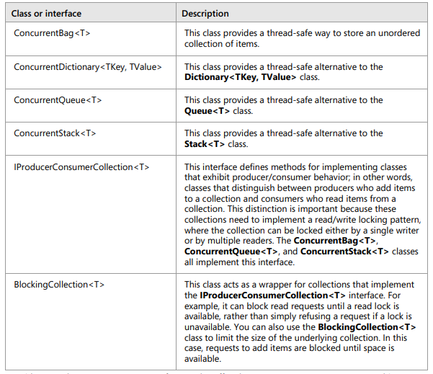
Concurrent collections

Slide 51
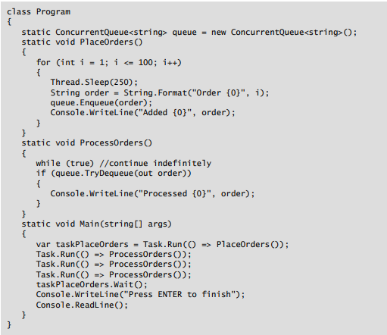
Concurrent collections

Slide 52
Threading best practices
https://docs.microsoft.com/en-us/dotnet/standard/threading/managed-threading-best-practices

Slide 53
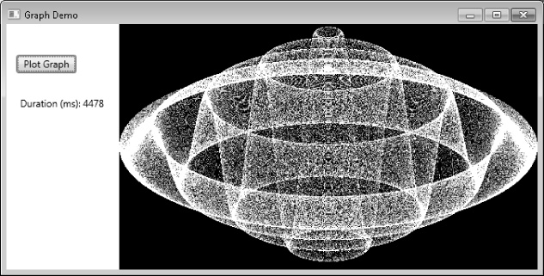
exercise
https://www.microsoftpressstore.com/articles/article.aspx?p=2228455&seqNum=2
https://github.com/patrickbiesheuveltraining/isah

Slide 54
New in .net
Top level statements
Pattern matching enhancements
https://docs.microsoft.com/en-us/dotnet/csharp/whats-new/csharp-9

Slide 55
Pattern matching
https://docs.microsoft.com/en-us/dotnet/standard/base-types/regular-expressions
https://docs.microsoft.com/en-us/dotnet/standard/base-types/regular-expression-language-quick-reference

Slide 56
Pattern matching enhancements
C# 9 includes new pattern matching improvements:
Type patterns match a variable is a type
Parenthesized patterns enforce or emphasize the precedence of pattern combinations
Conjunctive and patterns require both patterns to match
Disjunctive or patterns require either pattern to match
Negated not patterns require that a pattern doesn't match
Relational patterns require the input be less than, greater than, less than or equal, or greater than or equal to a given constant.

Slide 57
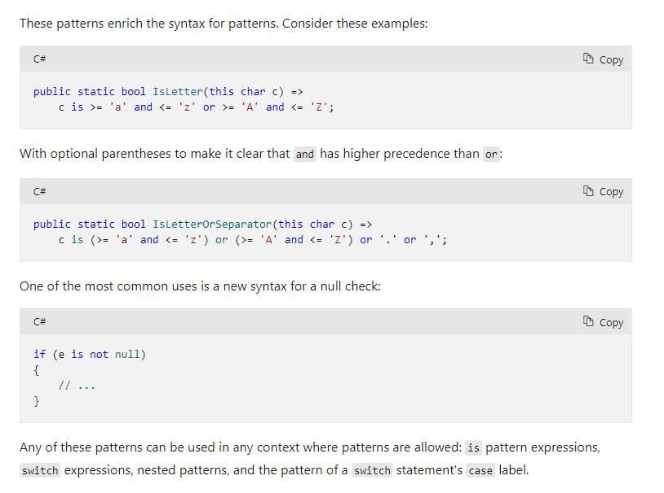

Slide 58
New in c# 10
https://docs.microsoft.com/en-us/dotnet/csharp/whats-new/csharp-10

Slide 59
$ - string interpolation
The $ special character identifies a string literal as an interpolated string. An interpolated string is a string literal that might contain interpolation expressions. When an interpolated string is resolved to a result string, items with interpolation expressions are replaced by the string representations of the expression results. This feature is available starting with C# 6.
https://docs.microsoft.com/en-us/dotnet/csharp/language-reference/tokens/interpolated#compilation-of-interpolated-strings

Slide 60
Global using directive
You can add the global modifier to any using directive to instruct the compiler that the directive applies to all source files in the compilation. This is typically all source files in a project.

Slide 61

File-scoped namespace declaration
You can use a new form of the namespace declaration to declare that all declarations that follow are members of the declared namespace:

Slide 62
New in c# 11
https://docs.microsoft.com/en-us/dotnet/csharp/whats-new/csharp-11

